Slide 1

Introduction to docker-compose

Slide 2
docker-compose
It is a tool for running multi-container applications
It uses yaml file to configure application services
Specifying image and configuration in a single yaml file
I,e docker-compose.yaml
One command which get it all running
$docker-compose up

Slide 3
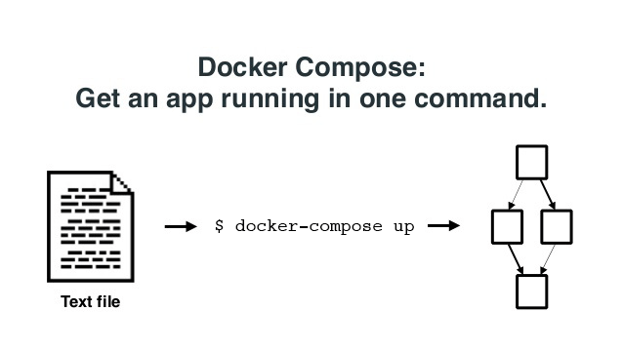
docker-compose up
Builds images from Dockerfiles
Pulls images from register
Creates and start container
Streams their logs

Slide 4
Simple steps to use docker-compose
Define your app’s environment with a Dockerfile so it can be reproduced anywhere
Define the services that make up your app in docker-compose.yml so they can be run together in an isolated environment
Lastly, run docker-compose up and Compose will start and run your entire app

Slide 5
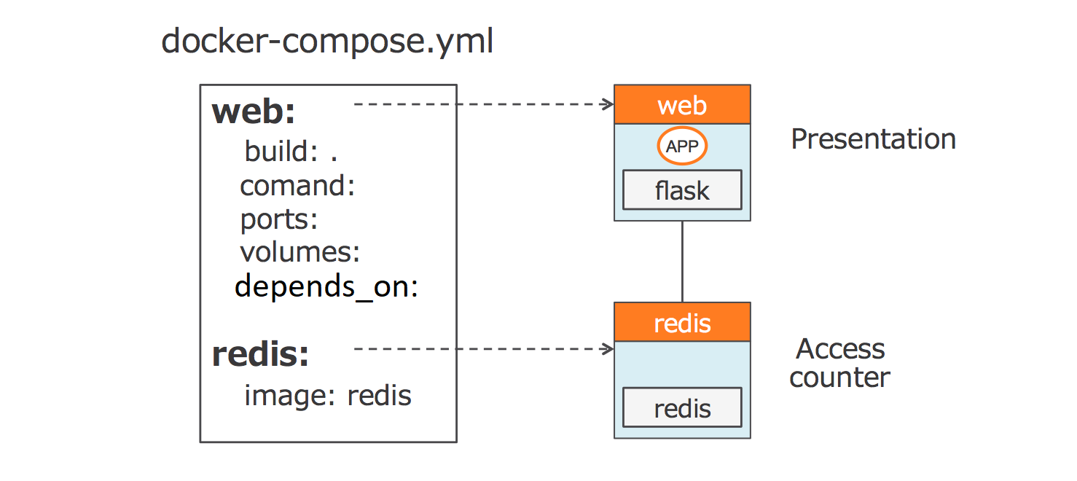
docker-compose example
version ‘3.0’
services:
web:
build: .
command:python app.py
ports:
- “5000:5000”
volumes:
- .:/code
depends_on:
- redis

Slide 6
docker-compose file syntax:
version - Specifies the Compose file syntax version
services - service is the name for a “Container in production”
networks - defines the network configuration used
volumes - Mounts a linked path on the host machine that can be used by the container
Directives:
image
Sets the image that will be used to build the container. Using this directive assumes that the specified image already exists either on the host or on Docker Hub

Slide 7
build
This directive can be used instead of image. Specifies the location of the Dockerfile that will be used to build this container
restart
Tells the container to restart if the system restarts
environment
Define environment variable to be passed in to the docker-compose command
depends_on
Sets a service as a dependency for the current block-defined container
port
Maps a port from the container to the host in the following manner: host:container

Slide 8
app.py:
from flask import Flask
from redis import Redis
import os
app = Flask(__name__)
redis = Redis(host='redis', port=6379)
@app.route('/')
def hello():
redis.incr('counter')
return'Hi! You saw me %s times.'% redis.get('counter')
if __name__ == "__main__":
app.run(host="0.0.0.0", debug=True)

Slide 9
requirements.txt:
flask
redis
Dockerfile:
FROM python:2.7
ADD . /code
WORKDIR /code
RUN pip install -r requirements.txt

Slide 10
Basic docker-compose commands
Command to start multi-container application
$docker-compose up
Command to start multic0ntainer application in demonized mode
$docker-compose up –d
Command to view containers created
$docker-compose ps
Command to stop containers
$docker-compose stop
Command to check the logs
$docker-compose logs
Access the application in browser
http://localhost:5000

Slide 11
Features of docker-compose
When a docker-compose up is done, by default a network will be created in the name of directory and all the services defined will be created as containers
All containers created by docker-compose will be connected to its own network created and thus providing isolation between other network containers
Containers will be able to communicate through service names as they are connected to same network

Slide 12
Thank You

